Slide 1
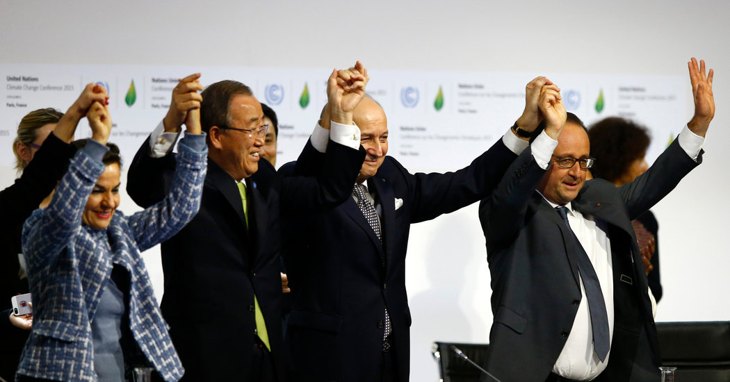
Nations Approve Landmark Climate Accord in Paris
Xinghai Zhang

Slide 2
LE BOURGET, France — With the sudden stroke of a gavel on Saturday night, representatives of 195 countries reached a landmark climate accord that will, for the first time, commit nearly every country to lowering planet-warming greenhouse gas emissions to help stave off the most drastic effects of climate change.

Slide 3
The coalition, formed to push for ambitious environmental provisions in the deal, includes a mix of rich countries, such as the United States and members of the European Union; island nations like Tuvalu and Kiribati, which are vulnerable to damage from rising sea levels; and countries with the strongest economies in Latin America, such as Brazil.

Slide 4
Poorer countries had pushed for a legally binding provision requiring that rich countries appropriate a minimum of $100 billion a year to help them mitigate and adapt to the ravages of climate change.

Slide 5
In the end, the final draft requires all countries to use the same system to report their emissions, but it allows developing nations to report fewer details until they build the ability to better count their carbon emissions.

Slide 6
The accord uses the language of an existing treaty, the 1992 United Nations Framework Convention on Climate Change, to put forth legally binding language requiring countries to verify their emissions, and to periodically put forth new, tougher domestic plans over time.

Slide 7
The End
Thank You

